Slide 1
Cognition Fundamentals: Refresher
Cognitive Models of Language Learning & Large Language Models
Responsible Lecturer: Bram Heijligers

Slide 2
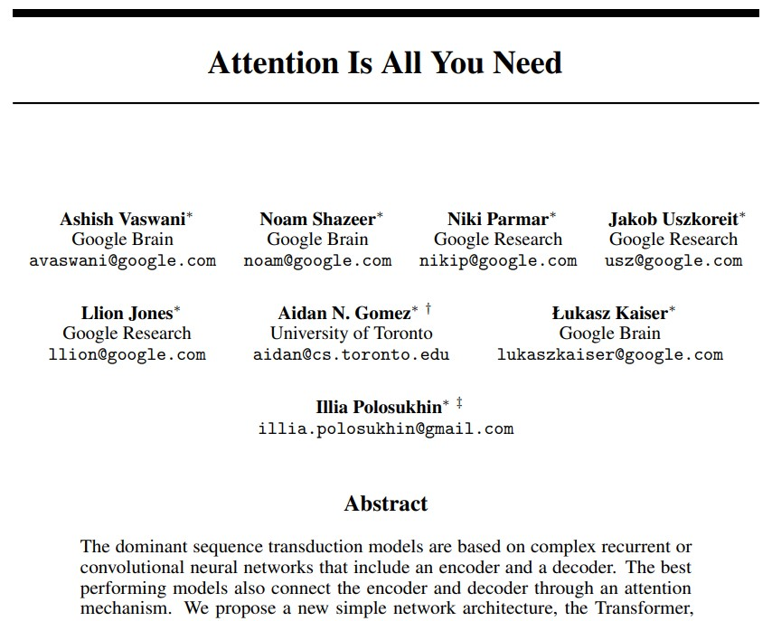
Going full-circle...

Slide 3
Table of Contents
Recap of:
Book chapter 1 - 5
---- SHORT BREAK ----
Large Language Models & Cognition
Recurrent Neural Networks
Transformers
How they connect
Afternoon:
Use-case 2 walkthrough
Feedback & Q&A

Slide 4
How do we learn language?
How do we acquire meaning?

Slide 5
What is Modeling of Language Learning?
Human language learning
Identify processes and mechanisms involved in learning language
Detect common behavioural patterns among children
(Computational) modeling
Simulate a cognitive process via computational tools and techniques
Use the model to explain the observed human behaviour
Modeling of language learning
Develop computational simulations of the process of human language acquisition

Slide 6
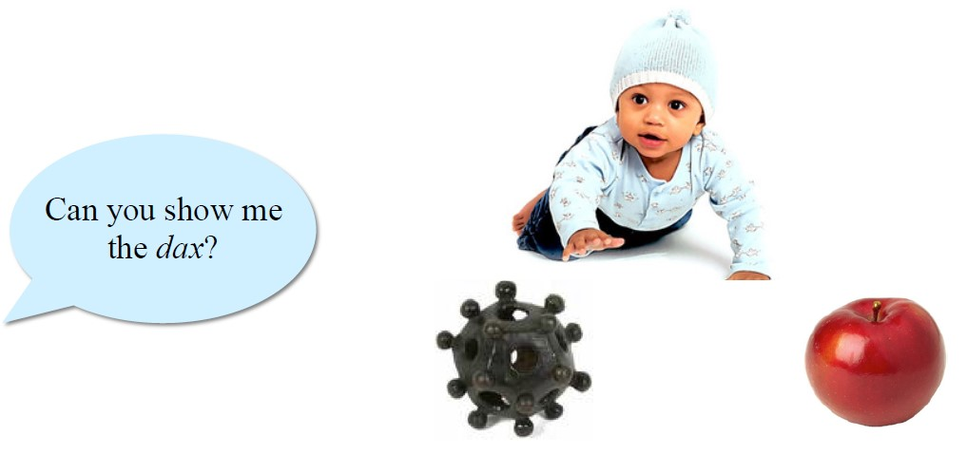
Word Meaning
Young children easily map novel words to novel objects in
familiar context
However, mapping words alone is not enough...

Slide 7
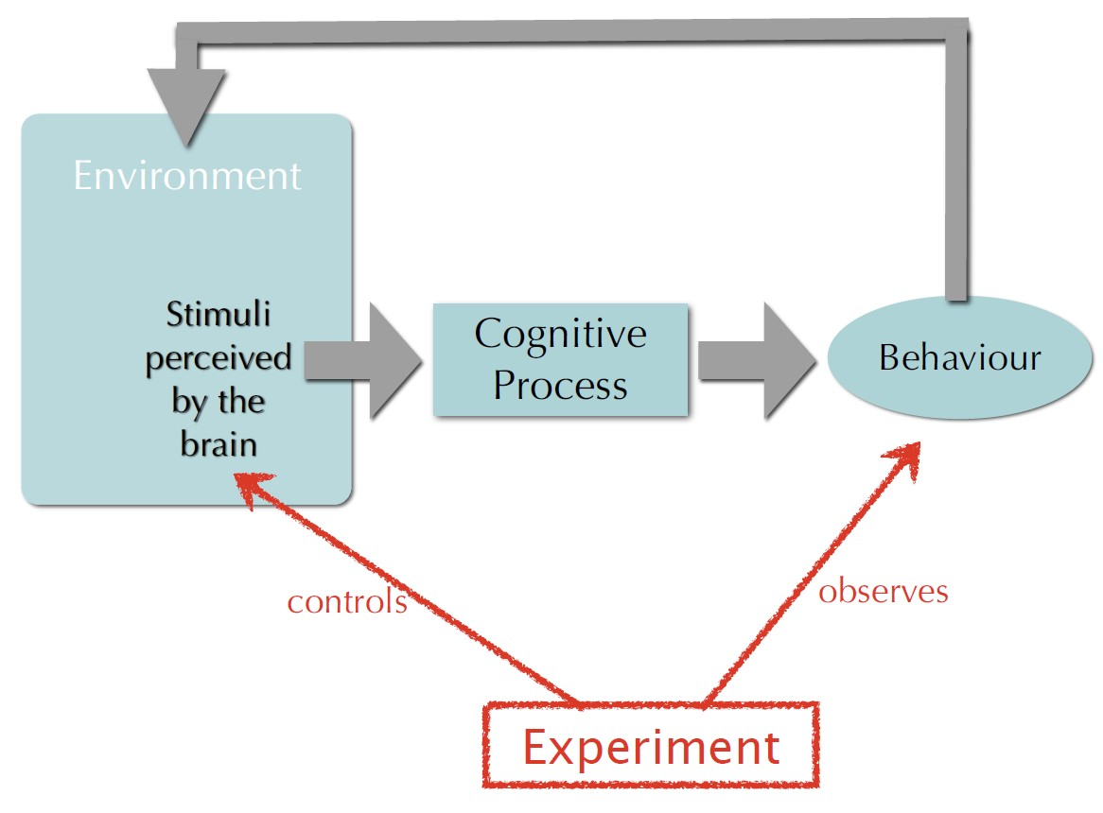
How do we learn the meaning of a word?
More complex... That’s were science comes in...

Slide 8
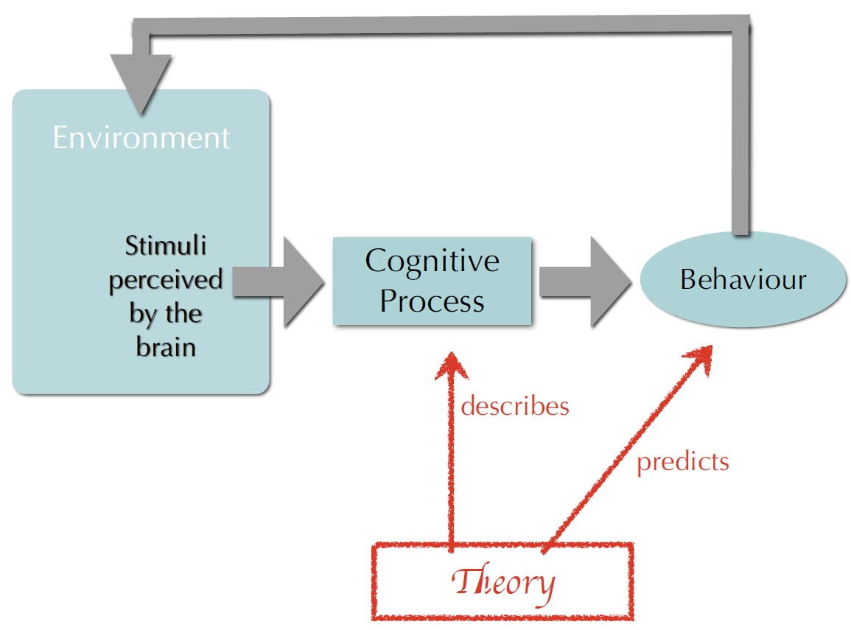
How do we learn the meaning of a word?
More complex... That’s were science comes in...

Slide 9
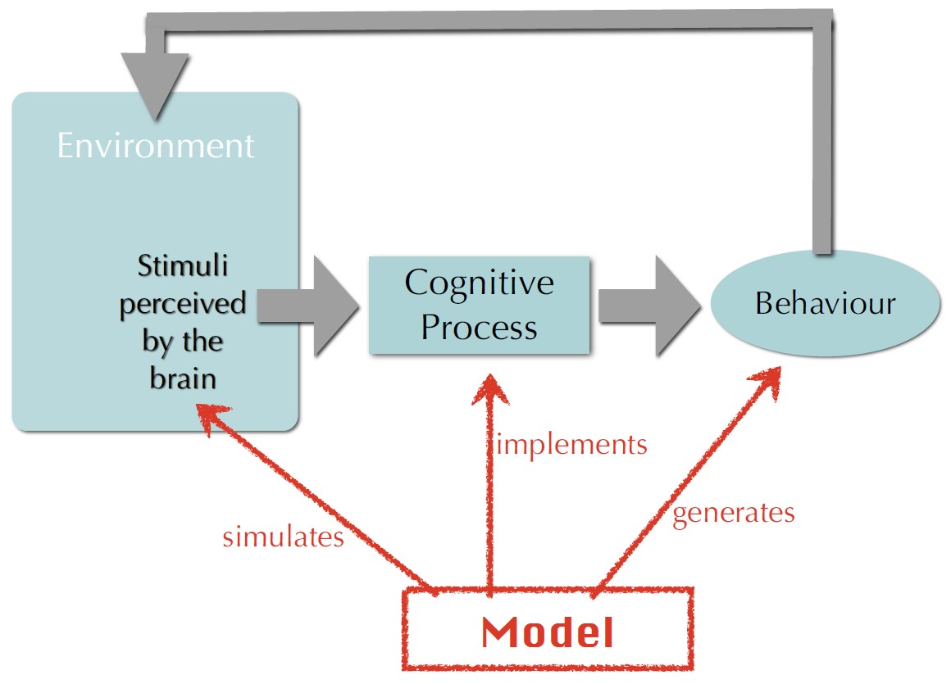
How do we learn the meaning of a word?
More complex... That’s were science comes in...

Slide 10
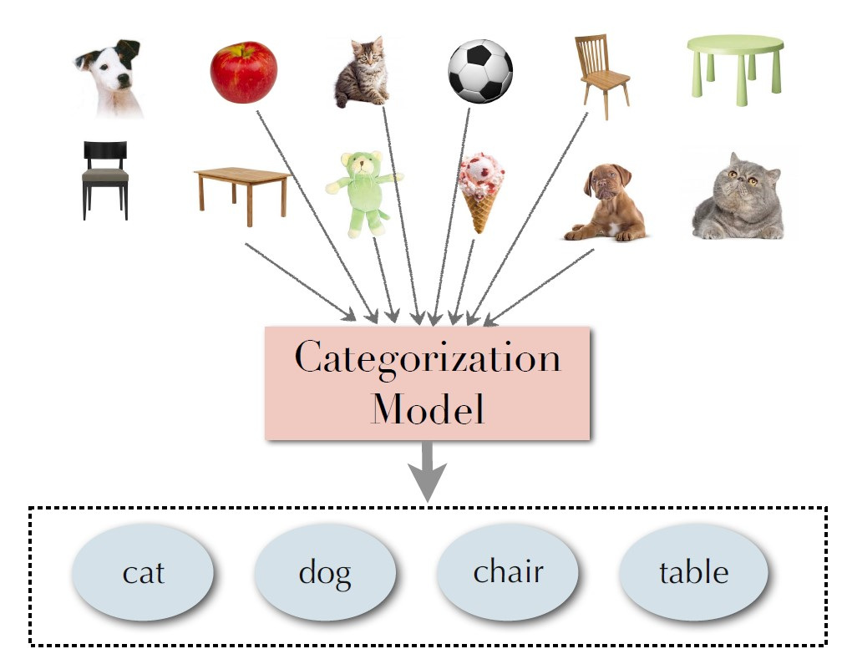
Assigning Meaning to a word
It all start with categories:
We all like to put things in boxes
It’s the most basic component to assign meaning

Slide 11
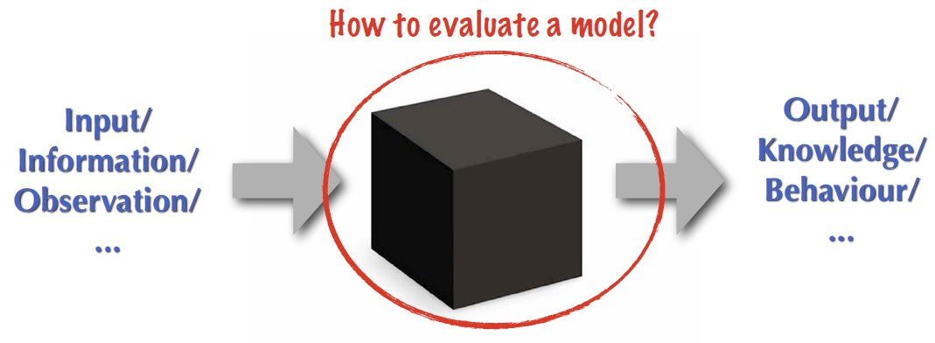
Language Acquisition Models:
How do we evaluate such models?
What humans know about language can only be estimated/evaluated through how they use it. Which means observing language:
Processing
Understanding
Production

Slide 12
Modelling Language Learning
Using computational methods for modelling cognitive processes of language learning enables us to:
study these processes through simulation;
evaluate the plausibility of existing theories of language learning and understanding;
explain the observed human behavior during the process of learning and using a natural language;
predict behavioural patterns that have not yet been experimentally investigated.

Slide 13
Various Aspects of Language Acquisition
Remember these for you use-cases!
Word segmentation: extract words from the speech stream, i.e.; splitting words into their respective parts
Phonology: acquire the sound system of the language, and the correct form of each word , i.e.; : how a language systematically organizes its sounds
Word meaning: map each word form to the concept it represents in the outer world
Morphology: learn the regularities governing the structure of each word form , i.e.; how a language systematically organizes its words and their respective relationships
Syntax: combine words and construct well-formed sentences , i.e.; the sentence structure and how it relates to phonology, morphology, sematics and pragmatics
Semantics: interpret the (relational) meaning of a phrase or sentence, i.e.; builds on syntax
Pragmatics and discourse: use context to augment the meaning , i.e.; how language is utilized in (social) interaction; builds on semantics
Idiosyncratic: peculiar or specific to

Slide 14
Types of modelling frameworks:
Symbolic: first generation of models influenced by early AI
Symbolic systems of knowledge representation; state-machine
Logic-based inference techniques; if-else
Connectionist: inspired by the architecture of human brain
Distributional representation of knowledge
Parallel processing of data
Probabilistic: following the success of statistical machine learning techniques
Combining descriptive power of symbolic models with the flexibility of the connectionist models
E.g. Large language models such as chatGPT

Slide 15
Questions?
Let’s start working on use-case 2!

Slide 16
Break
Take a walk of 5 minutes and meet me at the Innovation Square!

Slide 17
How do neural networks and cognition relate?
How does research into cognitive science drive developments in Artificial Intelligence?

Slide 18
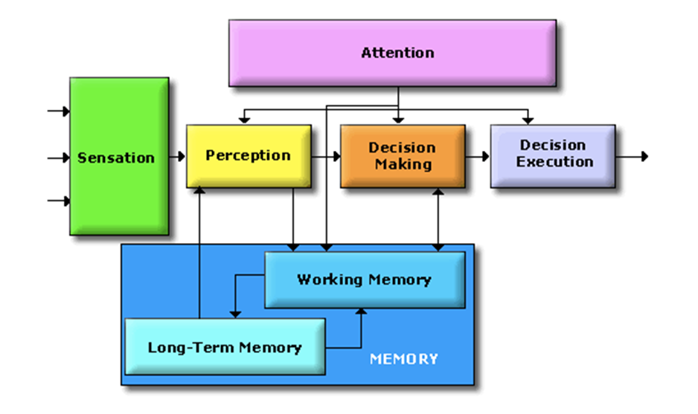
The Cognitive System
Which elements were present in your robotic AI?
Did it had sensors?
Was it able to perceive?
Was it able to make decisions and
execute these?
Was it able to store and retrieve
information?
So, what element here is not present in any of the AI system you have seen so far?
Why did we need attention?
Limited processing capacity → Selection!
To select the most relevant piece of information for the given context
Notes:
On the separate parts:
This approach is taken to aid clarity of explanation, but in so doing, can give the impression that individual aspects of cognition can be understood in isolation from each other. However, it is always important to remember that to properly understand the role of any single aspect of cognition we must appreciate how that role is dependent upon and interacts with other aspects.

Slide 19
Let’s translate a simple sentence to [Target Language]...
The cat eats the mouse.

Slide 20
How would we go about this?
The cat eats the mouse. → [Target Sentence]
Encode sentence to vector and decode sentence vector to target
Traditionally called sack-to-sack tasks
[0,0,0,0,0,0,0,0,0,0,0,0,0,0,0,0,0,0,0,0,0,0,0,0,0]
[Target Sentence]
Notes:
We would start by encoding the sentence to vectors and then decode it again. Somehow, the sentence needs to go into a vector. Translating these is traditionally called a sack-to-sack task

Slide 21
How would we go about this?
The cat eats the mouse → [Target Sentence]
Sack-to-sack task
Traditionally done with Recurrent Neural Network
E.g. Alice TN Network
Other early translators often gave strange results
Encode to words to word vectors
Turn to hidden state (H0) using Encoder (E)
[0,0,0] [0,0,0] [0,0,0,0] [0,0,0] [0,0,0,0,0]
E
Encoder
H0
Hidden State
[Target Sentence]
Notes:
Hidden State = The hidden state in a RNN is basically just like a hidden layer in a regular feed-forward network - it just happens to also be used as an additional input to the RNN at the next time step. Where f is some non-linear function, Wxh is a weight matrix of size h×x, and Whh is a weight matrix of size h×h.
Encoder = The encoder is built by stacking recurrent neural network (RNN). We use this type of layer because its structure allows the model to understand context and temporal dependencies of the sequences. The output of the encoder, the hidden state, is the state of the last RNN timestep

Slide 22
How would we go about this?
The cat eats the mouse → [Target Sentence]
Encode to words to word vectors
Turn to hidden state (H0) using Encoder (E)
Hidden State get plugged into the encoder of the next word vector
[0,0,0] [0,0,0] [0,0,0,0] [0,0,0] [0,0,0,0,0]
E
E
H0
H0
[Target Sentence]
Notes:
We would start by encoding the sentence to vectors and then decode it again. Somehow, the sentence needs to go into a vector. Translating these is traditionally called a sack-to-sack task

Slide 23
How would we go about this?
The cat eats the mouse → [Target Sentence]
Sack-to-sack task
Traditionally done with Recurrent Neural Network
E.g. Alice TN Network
Other early translators often gave strange results
Encode to words to vectors
Turn to hidden state (H0) using Encoder (E)
Decode vectors to target words
[0,0,0] [0,0,0] [0,0,0,0] [0,0,0] [0,0,0,0,0]
E
E
E
E
E
H0
H0
H0
H0
H0
[Target Sentence]
Notes:
We would start by encoding the sentence to vectors and then decode it again. Somehow, the sentence needs to go into a vector. Translating these is traditionally called a sack-to-sack task

Slide 24
How would we go about this?
The cat eats the mouse → [Target Sentence]
Sack-to-sack task
Traditionally done with Recurrent Neural Network
E.g. Alice TN Network
Other early translators often gave strange results
Encode to words to vectors
Turn to hidden state (H0) using NN
Decode vectors to target words
[0,0,0] [0,0,0] [0,0,0,0] [0,0,0] [0,0,0,0,0]
NN
H0
H0
H0
H0
H0
[Target Sentence]
Notes:
We would start by encoding the sentence to vectors and then decode it again. Somehow, the sentence needs to go into a vector. Translating these is traditionally called a sack-to-sack task

Slide 25


Slide 27
Questions?
Let’s start working on use-case 2!

Slide 28
Slide Graveyard

Slide 29
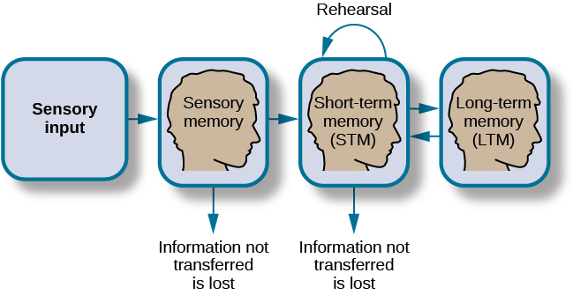
How memory functions

Slide 30
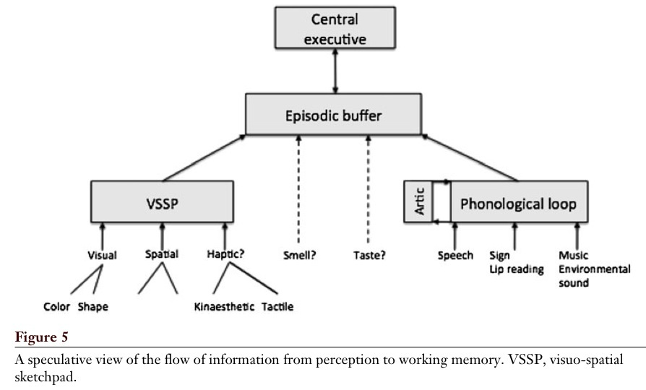
Working Memory for Perception
Baddeley, 2012

Slide 31
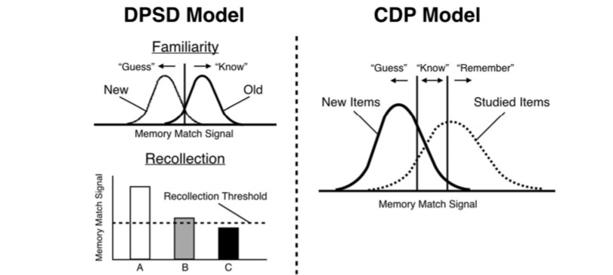
Familiarity vs. Recollection: The DPSD and CDP Models
Notes:
DPSD = dual-process signal-detection
The dual-process signal-detection (DPSD) model assumes that recognition memory is based on recollection of qualitative information or on a signal-detection-based familiarity process.
CDP = continuous dual process
The dual-process theory of recognition memory holds that recognition ‘decisions’ can be based on either recollection or familiarity, and the gues/know/remember procedure is seen as continuous flow and see recollection as a stronger form of familiarity.
What’s important to remember is that the signals stored in the long-term memory is compared to that in the working-memory.

Slide 32
Active Sampling - (Learning)
A type of cognitive strategy in which a person actively engages with their environment in order to acquire new knowledge or information. Can include:
intentional exploration of unfamiliar surroundings;
taking part in activities that provide new experiences;
and actively seeking out new sources of information
Active sampling is seen as a more efficient way for people to learn and acquire new knowledge as it involves actively engaging with the environment rather than passively absorbing information.

Slide 33
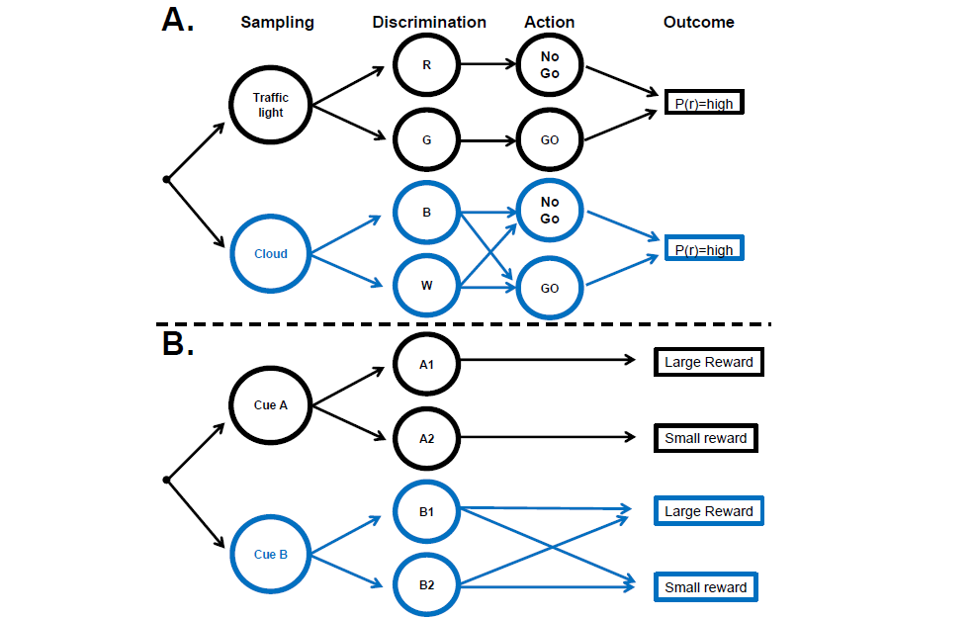
Decision chains for sampling and action
Gottlieb, 2018

Slide 34
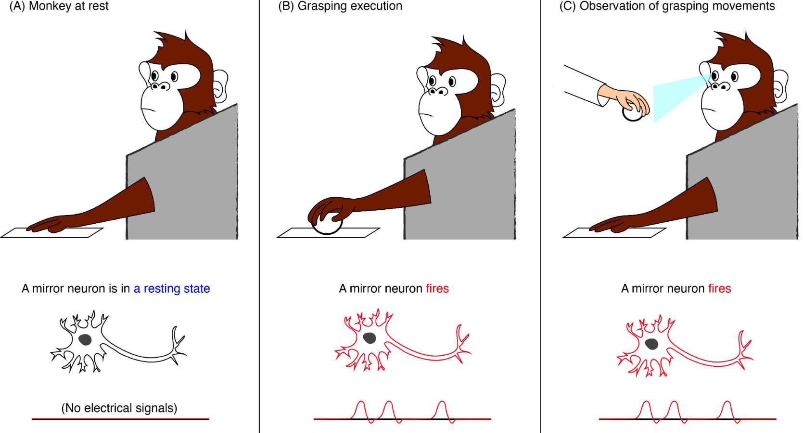
Mirror-Neurons – (learning)

